Slide 1
7
y = x +1
(5,7)
6
5
(4,5)
4
(1,3)
(3,4)
3
2
(2,2)
1
1
2
3
4
5
6
7

Slide 2
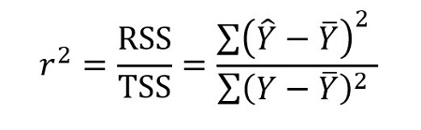
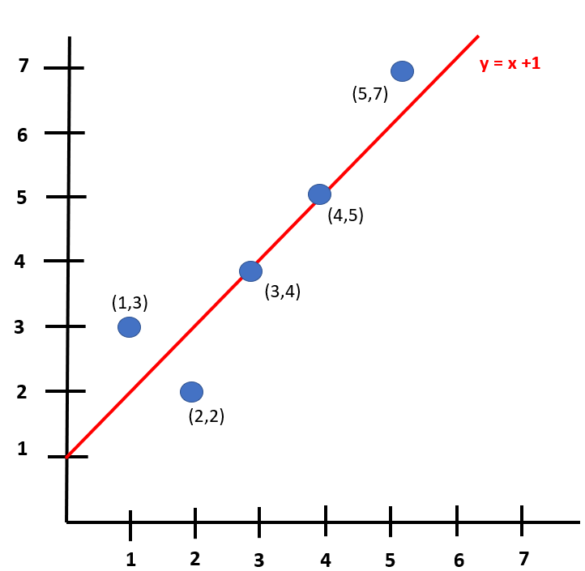
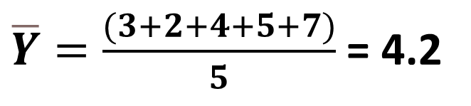
Actual data (Y)
Predicted data (Ŷ)
Y | X
3 | 1
2 | 2
4 | 3
5 | 4
7 | 5
Ŷ | X
2 | 1
3 | 2
4 | 3
5 | 4
6 | 5
$\overline{Y}=\frac{(3+2+4+5+7)}{5}$ = 4.2

Slide 3
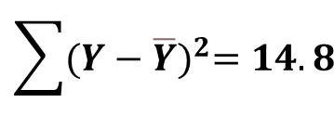
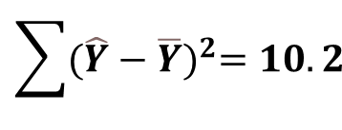
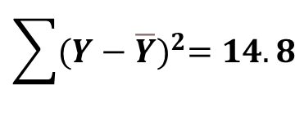

Ŷ | Ŷ – 4.2 | (Ŷ – 4.2)²
2 | -2.2 | 4.84
3 | -1.2 | 1.44
4 | -0.2 | 0.04
5 | 0.8 | 0.64
6 | 1.8 | 3.24
Y | Y – 4.2 | (Y – 4.2)²
3 | -1.2 | 1.44
2 | -2.2 | 4.84
4 | -0.2 | 0.04
5 | 0.8 | 0.64
7 | 2.8 | 7.84
$$\sum{{(\hat{Y}−\overline{Y})}^{2}=10.2}$$
$$\sum{{(Y−\overline{Y})}^{2}=14.8}$$
r² = 0.6892
$$\sum{{(\hat{Y}−\overline{Y})}^{2}=10.2}$$
$$\sum{{(Y−\overline{Y})}^{2}=14.8}$$

Slide 4
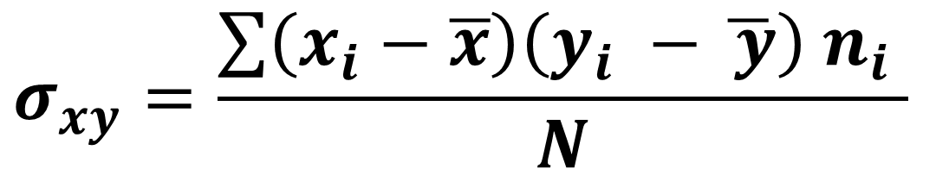
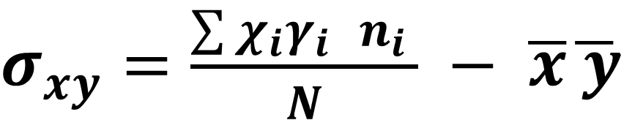
Covariance
$$σ_{xy}=\frac{\sum{\left(x_{i}−\overline{x}\right)\left(y_{i} −\overline{ y}\right) n_{i}} }{N}$$
$σ_{xy}=\frac{\sum{χ_{i}γ_{i }n_{i}} }{N} − \overline{x}\overline{ y}$

Slide 5

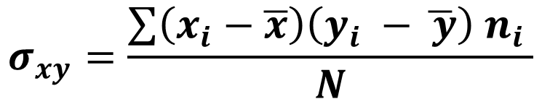

7
$$σ_{xy}=\frac{\sum{\left(x_{i}−\overline{x}\right)\left(y_{i} −\overline{ y}\right) n_{i}} }{N}$$
6
5
$$\overline{ y}$$
4
3
2
1
1
2
3
$$\overline{x}$$
5
6
7
4

Slide 6
7
$$σ_{xy}=\frac{\sum{\left(x_{i}−\overline{x}\right)\left(y_{i} −\overline{ y}\right) n_{i}} }{N}$$
6
5
$$\overline{ y}$$
4
3
2
1
1
2
3
$$\overline{x}$$
5
6
7
4

Slide 7

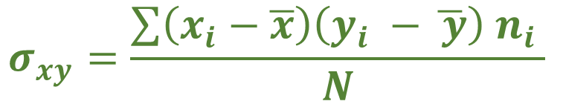

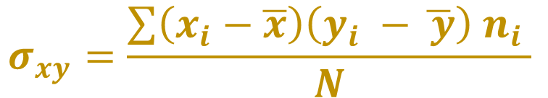
+
+
7
$$σ_{xy}=\frac{\sum{\left(x_{i}−\overline{x}\right)\left(y_{i} −\overline{ y}\right) n_{i}} }{N}$$
$$>0$$
6
5
$$\overline{ y}$$
4
-
-
$$σ_{xy}=\frac{\sum{\left(x_{i}−\overline{x}\right)\left(y_{i} −\overline{ y}\right) n_{i}} }{N}$$
$$>0$$
3
2
1
1
2
3
$$\overline{x}$$
5
6
7
4

Slide 8




-
+
7
$$σ_{xy}=\frac{\sum{\left(x_{i}−\overline{x}\right)\left(y_{i} −\overline{ y}\right) n_{i}} }{N}$$
$$<0$$
6
5
$$\overline{ y}$$
+
-
4
$$σ_{xy}=\frac{\sum{\left(x_{i}−\overline{x}\right)\left(y_{i} −\overline{ y}\right) n_{i}} }{N}$$
$$<0$$
3
2
1
1
2
3
$$\overline{x}$$
5
6
7
4

Slide 9
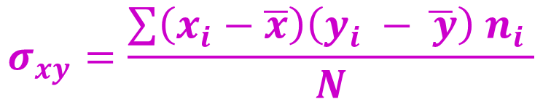
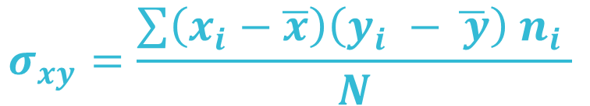

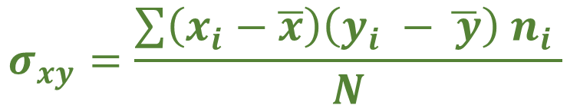
$$σ_{xy}=\frac{\sum{\left(x_{i}−\overline{x}\right)\left(y_{i} −\overline{ y}\right) n_{i}} }{N}$$
7
6
$$σ_{xy}=\frac{\sum{\left(x_{i}−\overline{x}\right)\left(y_{i} −\overline{ y}\right) n_{i}} }{N}$$
5
$$\overline{ y}$$
4
3
$$σ_{xy}=\frac{\sum{\left(x_{i}−\overline{x}\right)\left(y_{i} −\overline{ y}\right) n_{i}} }{N}$$
2
1
$$σ_{xy}=\frac{\sum{\left(x_{i}−\overline{x}\right)\left(y_{i} −\overline{ y}\right) n_{i}} }{N}$$
1
2
3
$$\overline{x}$$
5
6
7
4

Slide 10
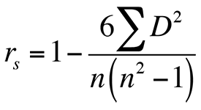
Rho of Spearman
Perfect
negative
correlation
Moderate
negative
correlation
Moderate
positive
correlation
Perfect
positive
correlation
-1
-0.75
0
-0.5
0.5
0.75
1
High
negative
correlation
No
correlation
High
positive
correlation

